Slide 1
CURE app
System Design
Brian Goughner Nakava Kibunzi Joshua Brown
Chauncey Davidson Charles S. Stamey

Slide 2
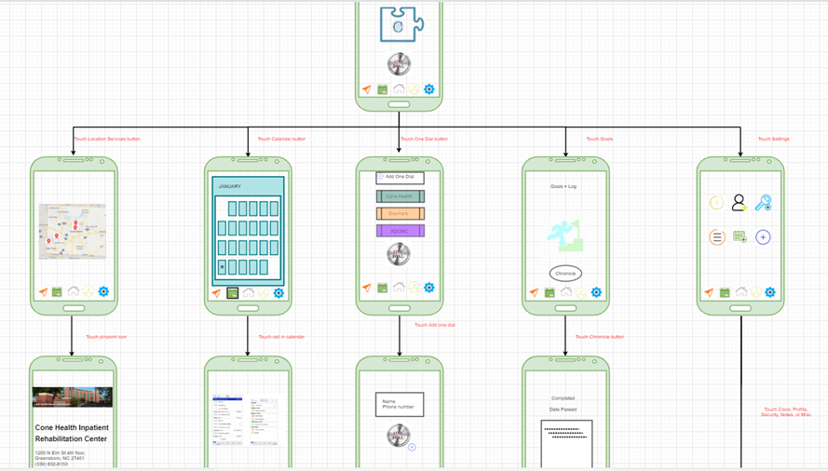
Mockup
Diagram

Slide 3
The Subsystems
Calendar
Goal Tracker/Chronicles
Map/Location
Hot Dial
Settings

Slide 4
Calendar
Inputs received by Map/Location service when user signs up for an event; displays in cell
Message passing to Goal Tracker/Chronicle
User modifies cells via tap-and-edit interaction
Displays future calendar months

Slide 5
Goal Tracking (Chronicle)
Displays Goals agenda with requirements to complete goals
Event Goals are uneditable, and are controlled through events through Location
Users have ability to create new goals, manually

Slide 6
Map and Location
Receives events and map information from the database and maps them in a radius centered from user location
Uses Google Maps API
Touch menu shows event details and number of attendees under each event
Import chosen events to update Goal Tracking and Calendar when an event is scheduled, rescheduled, or cancelled

Slide 7
Hot Dial
Self-contained module
Large, colorful buttons to contacts
Displays a pop up window with their number when clicked
Adding/Removing new numbers

Slide 8
Settings
Interconnected via event system to other subsystems.
Contains security preferences such as:
Password Setup
App Icon Anonymity
Menu Customization
Choose theme
Font
Event scheduling
Radius changes
Automatic goal tracking
Notifications

Slide 9
Operation/Algorithm Analysis
Operation/Algorithm | Time Complexity
Application Operations | O(1)
Event Attendance Query | O(1)
Event/Location Loading from Database | O(n)

Slide 10
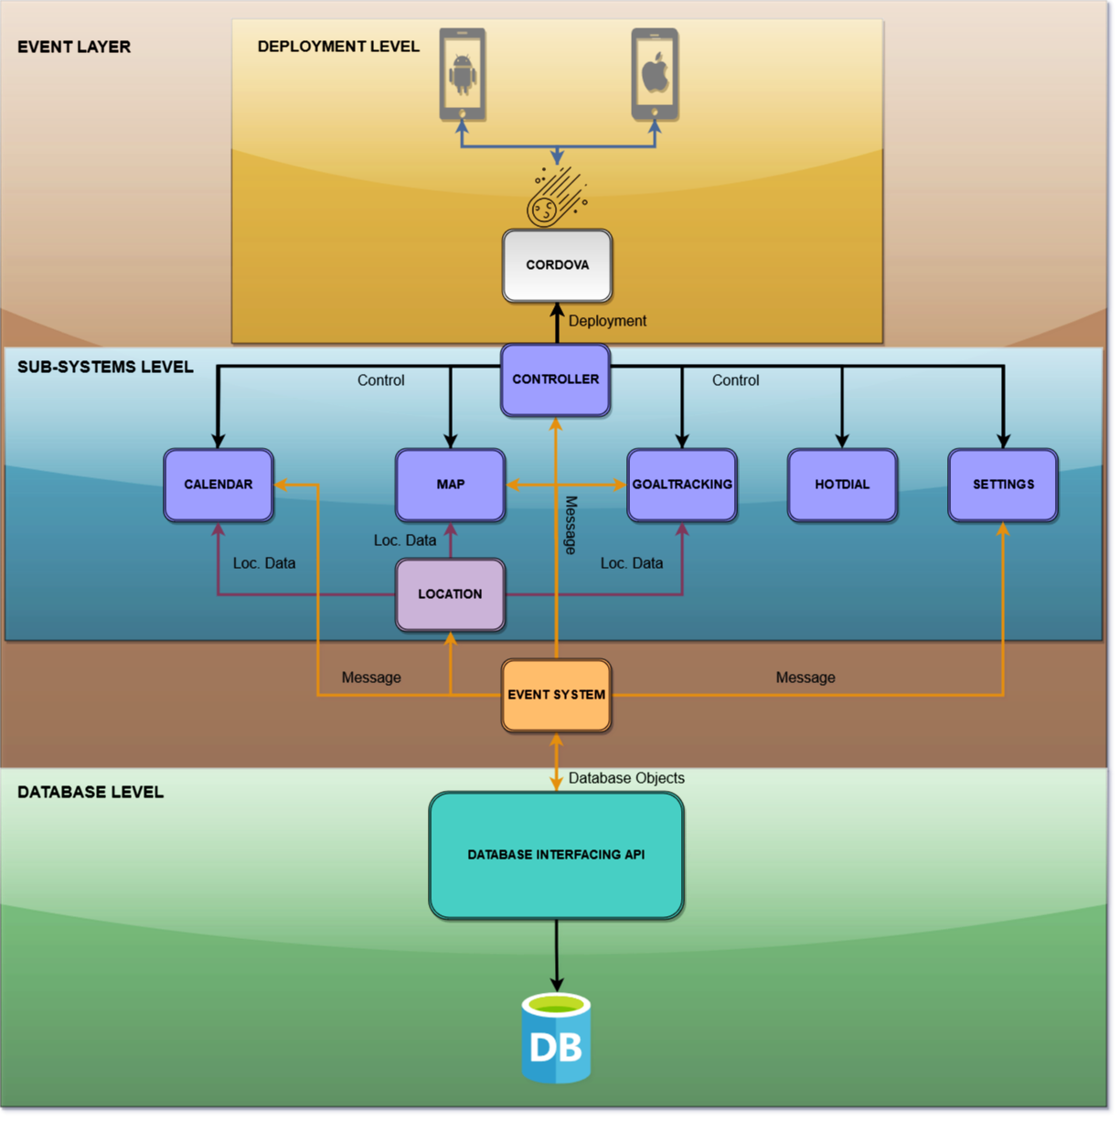

Slide 11
Subsystem Communication
Generality
Event-driven
Local events
Global message passing
Database Interface
API calls
Database Objects

Slide 12
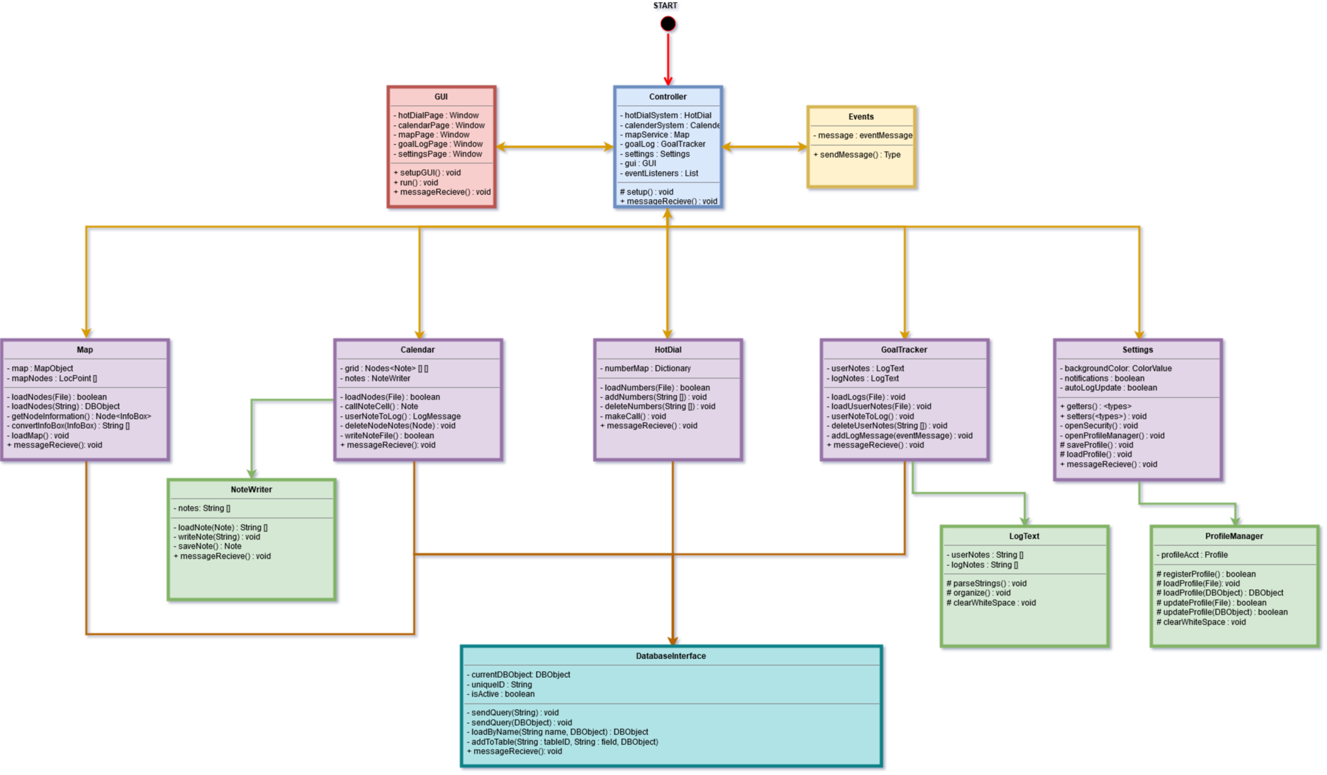
UML

Slide 13

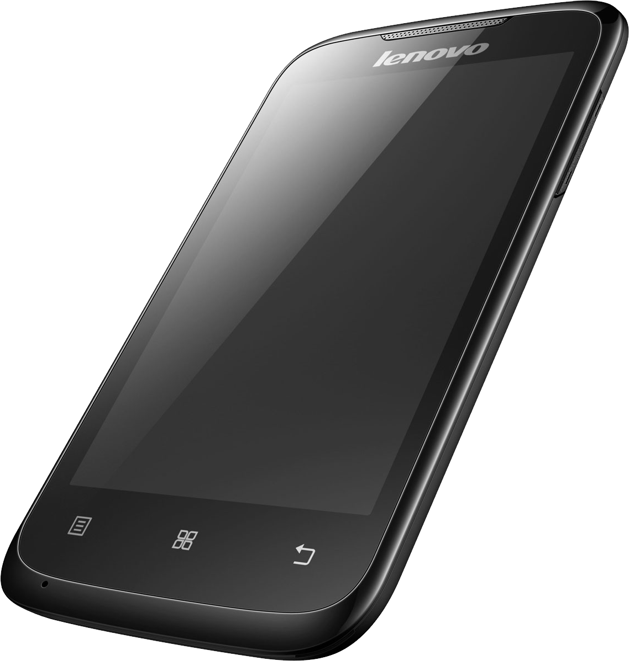
Entity Relationship Model

Slide 14
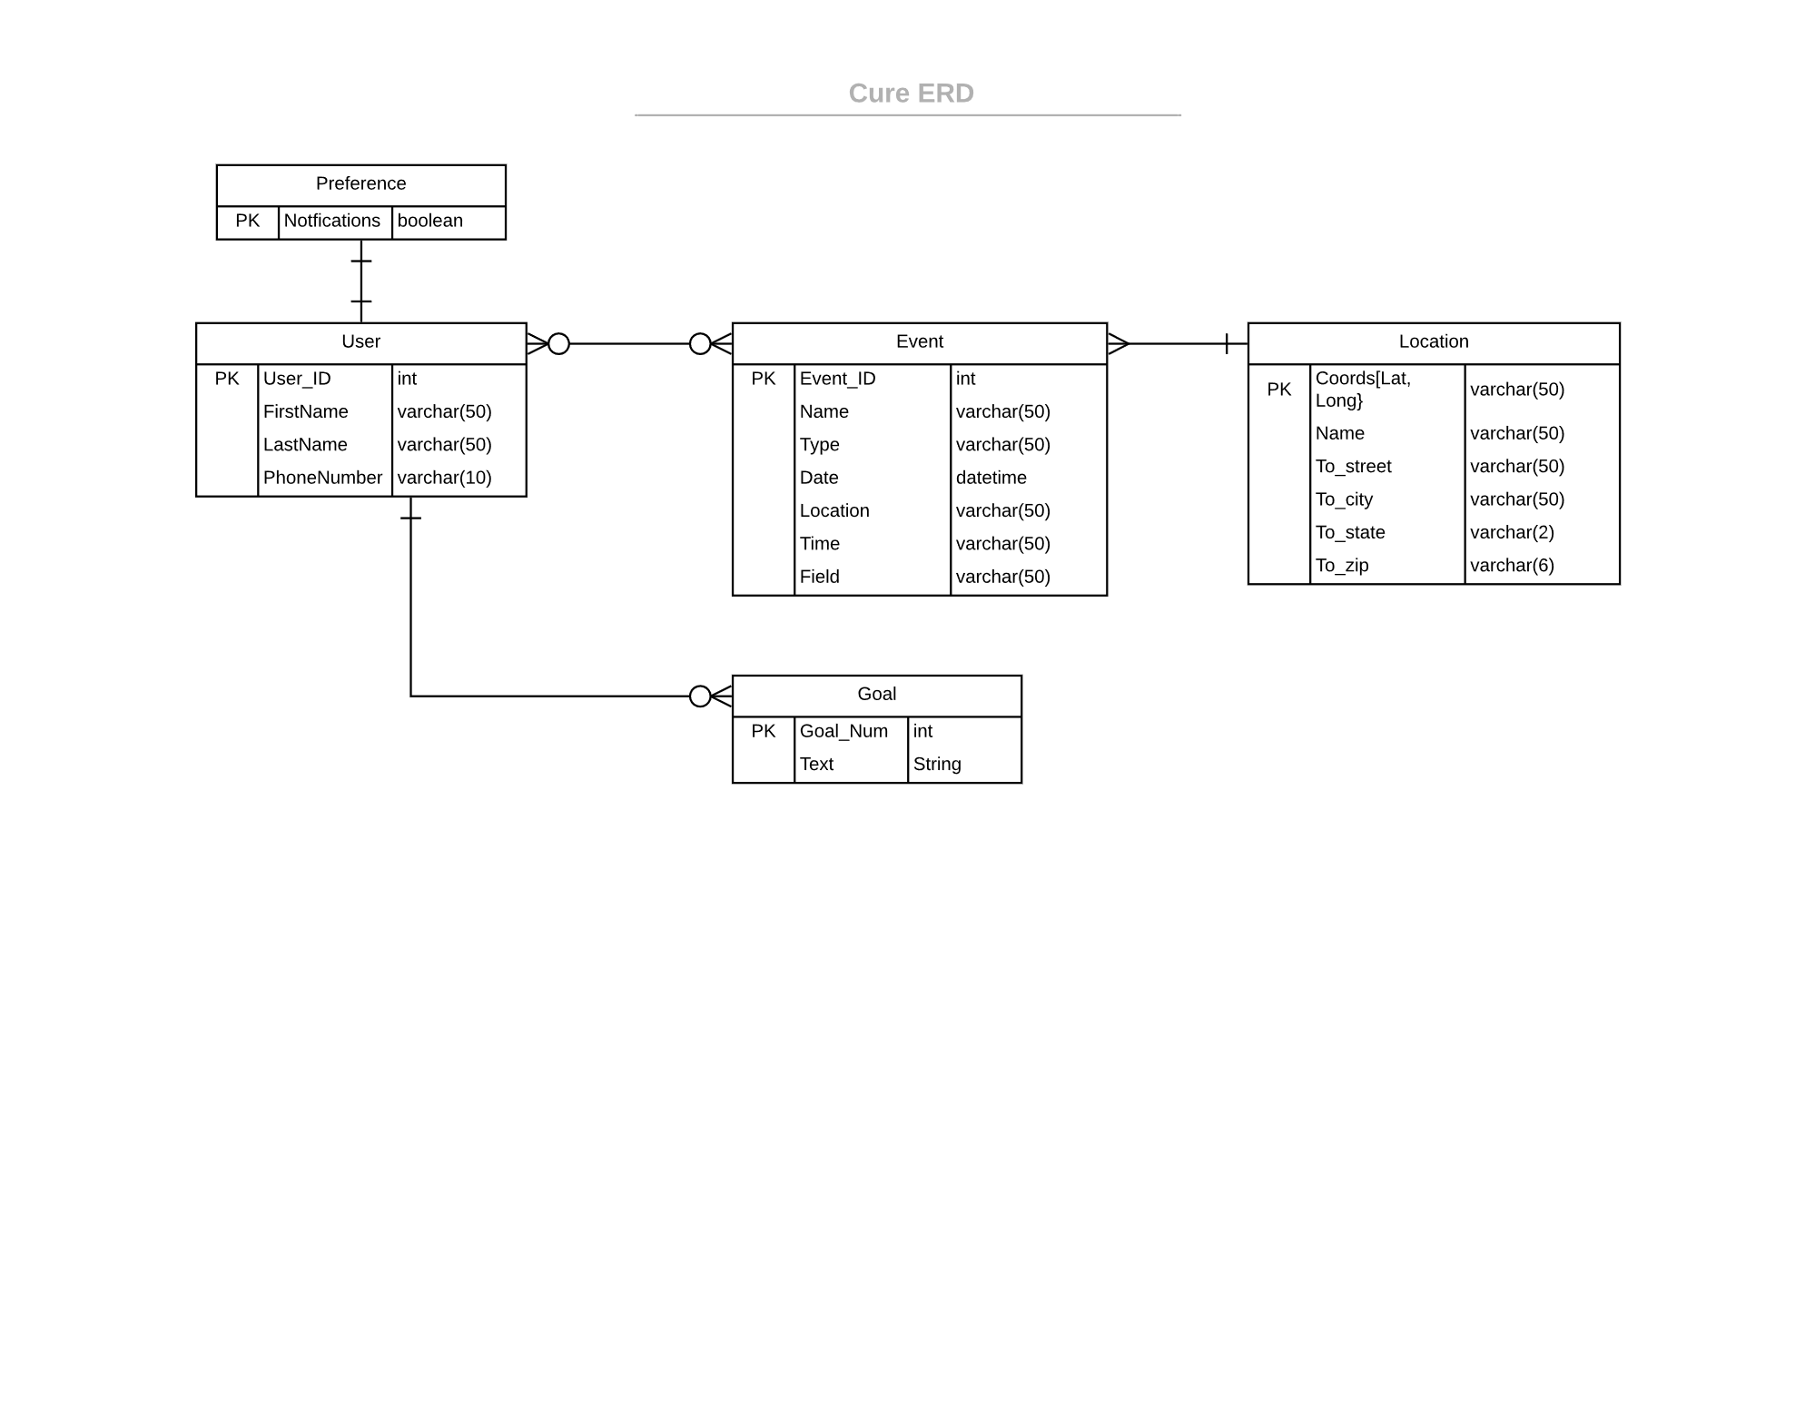
ER
Diagram

Slide 15
Data Dictionary - Event
Variable | Variable Name | Measurement Unit | Allowed Values | Description
Event Identification Number (PK) | ID | int | 00000-99999 | ID number assigned to events in sequential order
Event Name | name | char(50) | String of Characters | Name of the event
Event Type | type | char(50) | String of Characters | Displays what kind of event to expect
Event Date | date | mm/dd/yyyy | 01-12/1-31/2000-3000 | Date of event
Event Time | time | int | 0000-2359 | Time of event
Event Location | location_name | char(50) | String of Characters | Name of event venue, from location table

Slide 16
Data Dictionary - Location
Variable | Variable Name | Measurement Unit | Allowed Values | Description
Location Coordinates (PK) | location_lat_long | (double, double) | (0.0-9999.9,0.0-9999.9) | The location on the map so that Google Maps can find and place it
Location Name | name | char(50) | String of Characters | Name of the event location
Street Location Name | loc_name | char(50) | String of Characters | Name of the street of the event
State Name | state | char(2) | String of 2 Characters | Two-character string showing state
City Name | city | char(50) | String of Characters | Name of city
ZIP Code | zip | int | 00001-99999 | ZIP Code of event

Slide 17
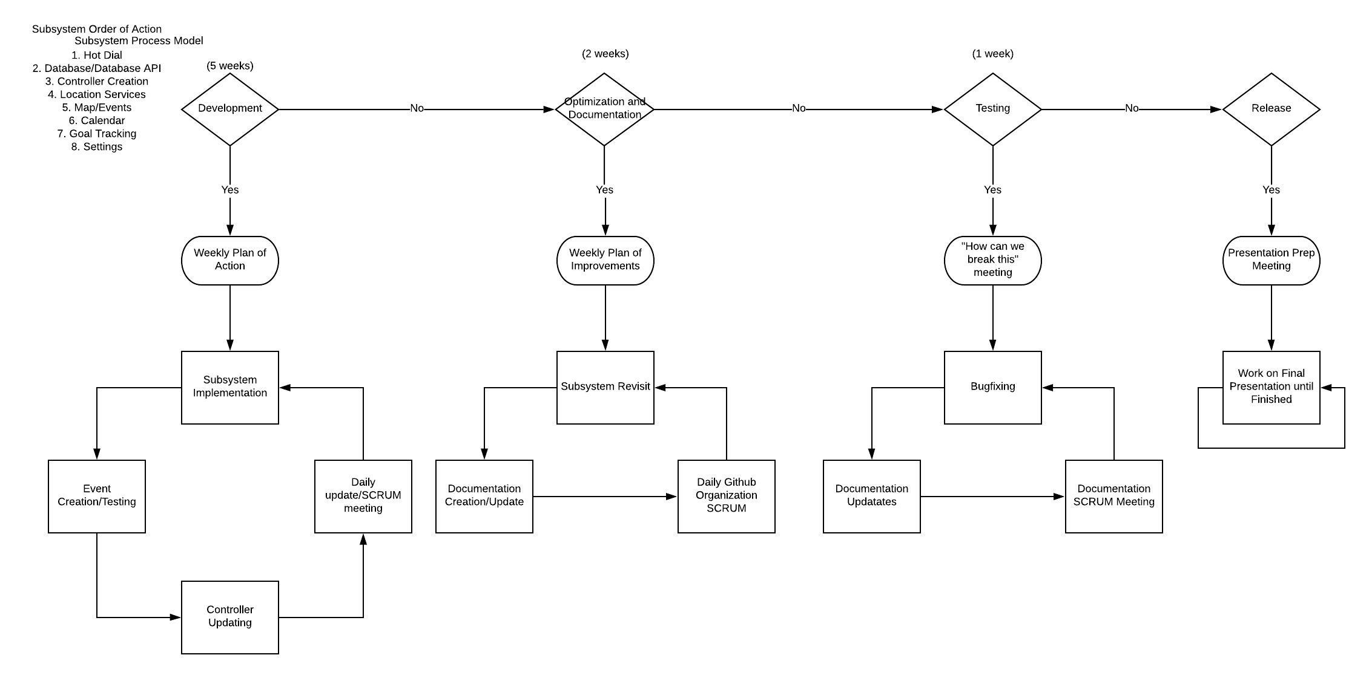
Agile Process Model

Slide 18
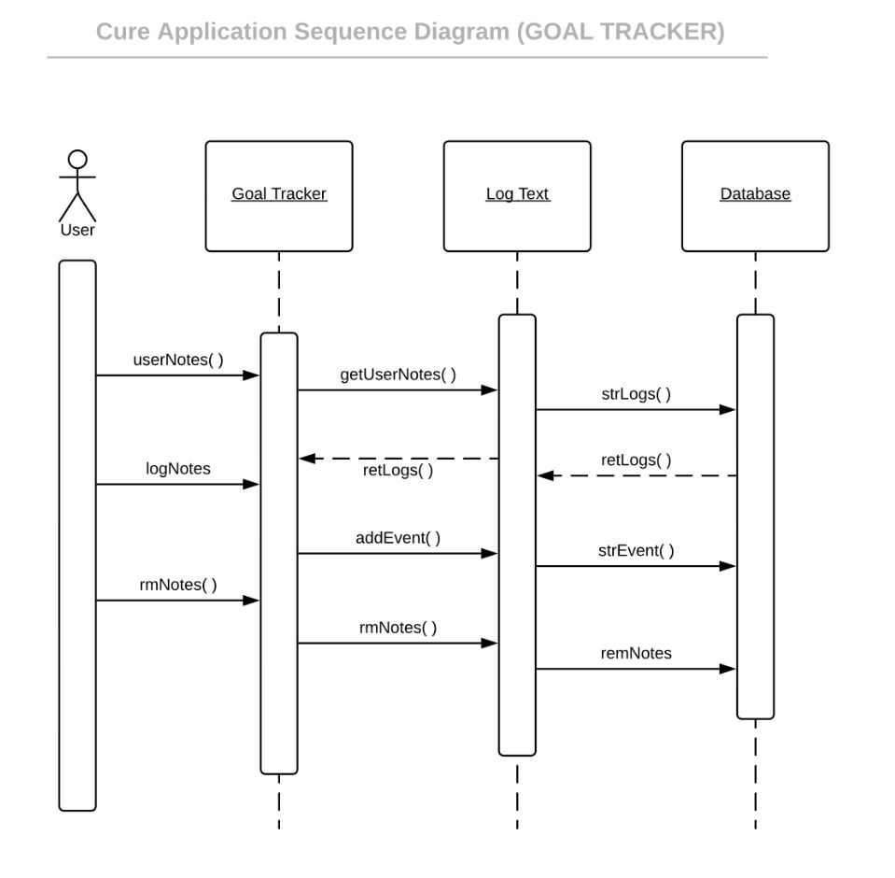
Place your screenshot here
Goals

Slide 19
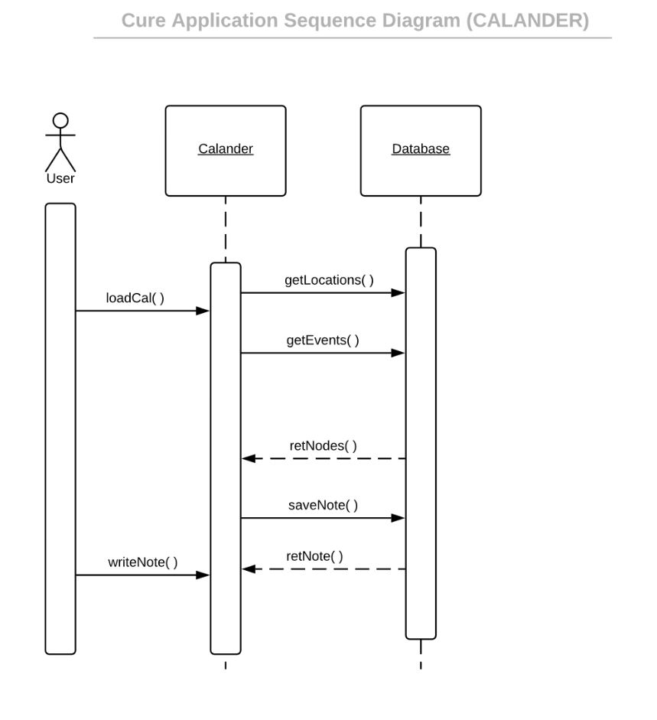
Place your screenshot here
Calendar

Slide 20
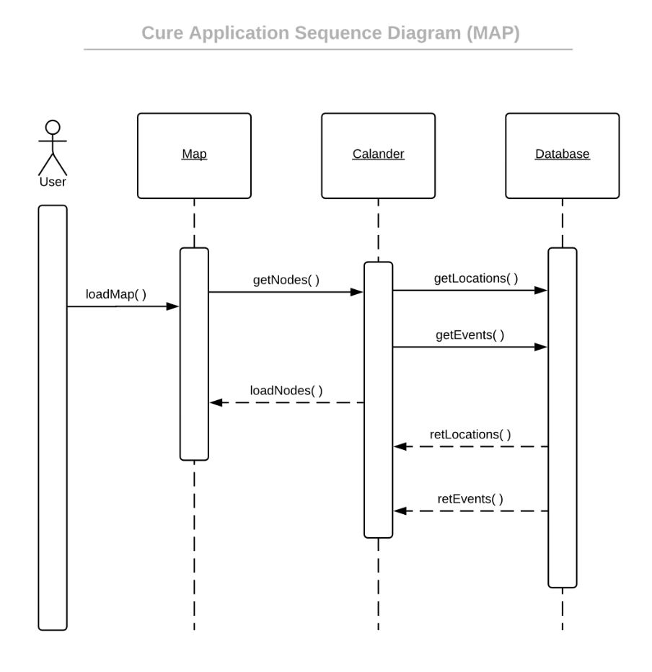
Place your screenshot here
Map

Slide 21
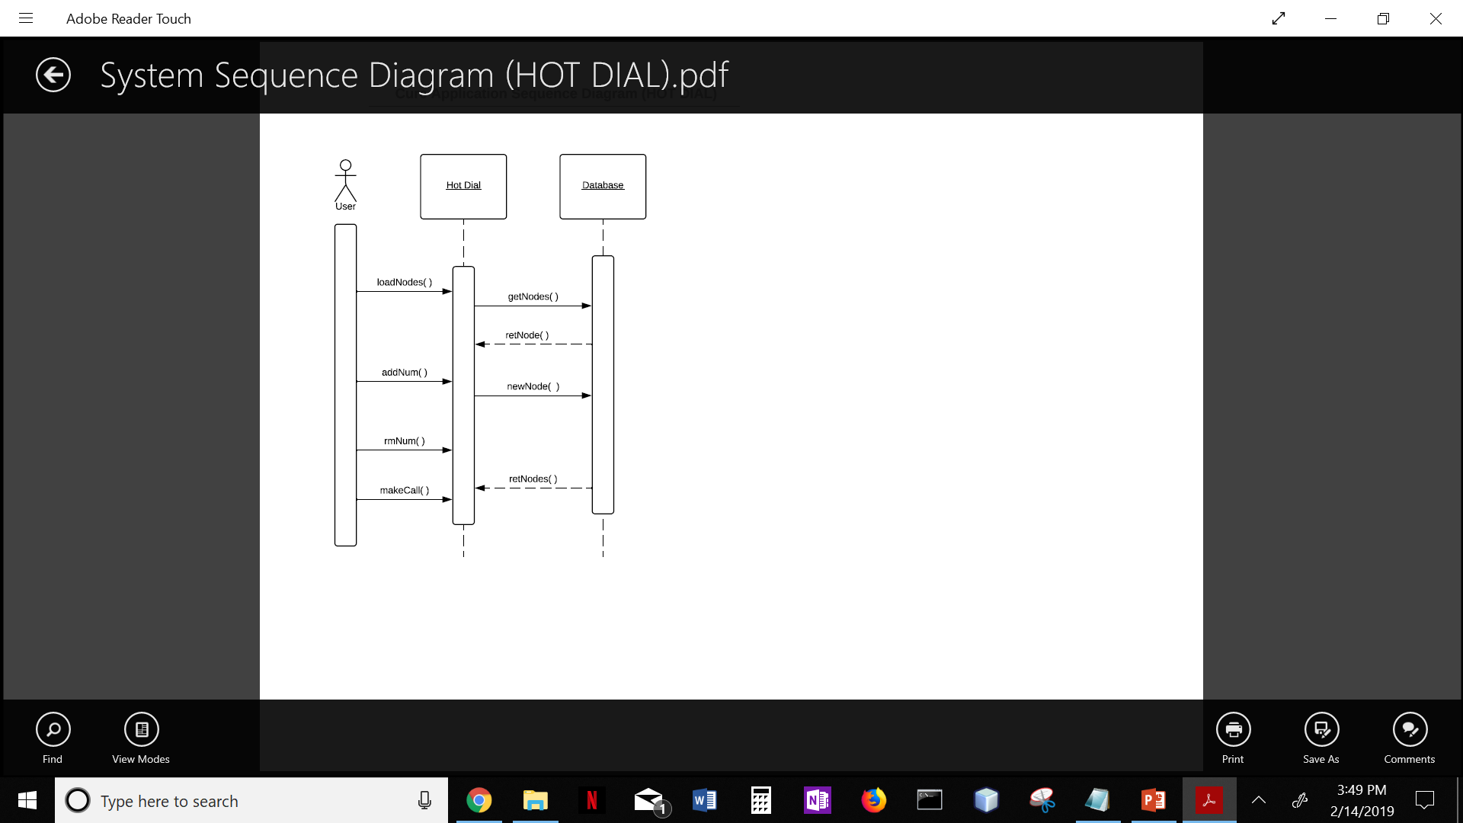
Place your screenshot here
Hot Dial

Slide 22
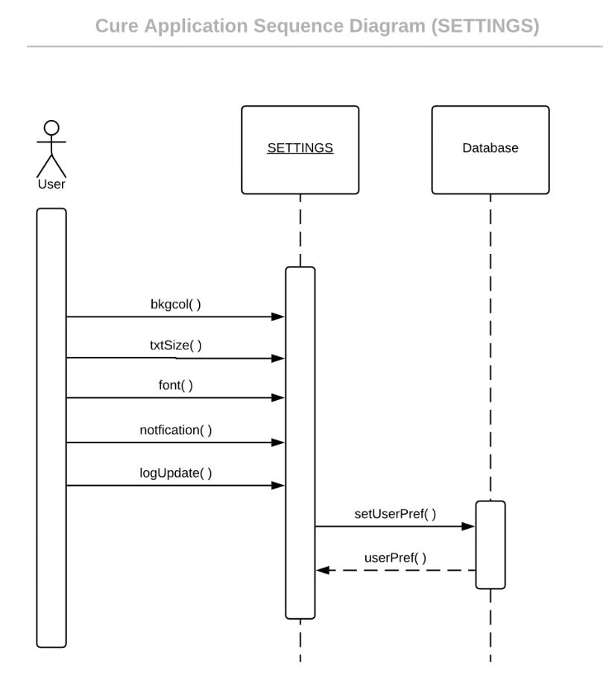
Settings
Place your screenshot here

Slide 23
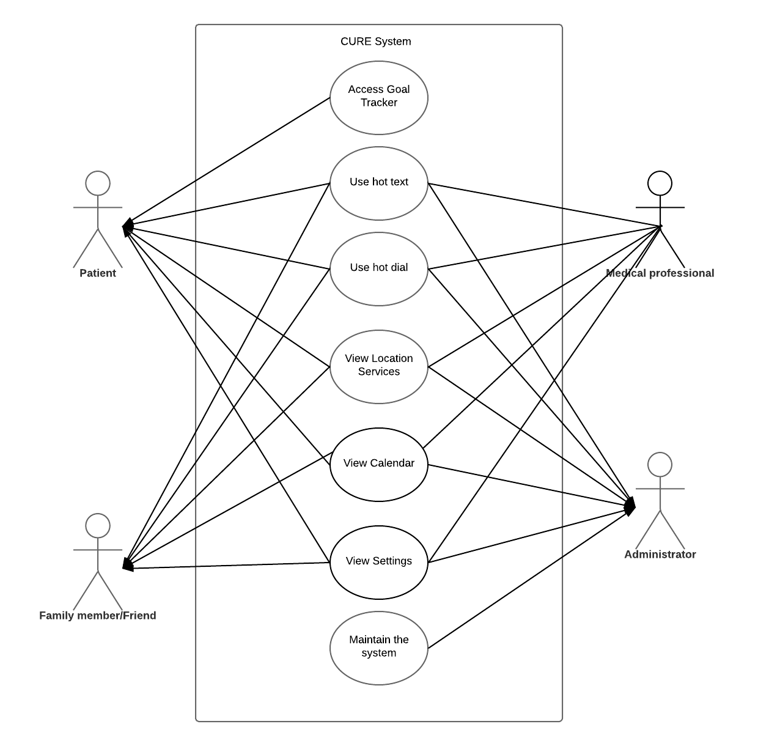
CURE System

Slide 24
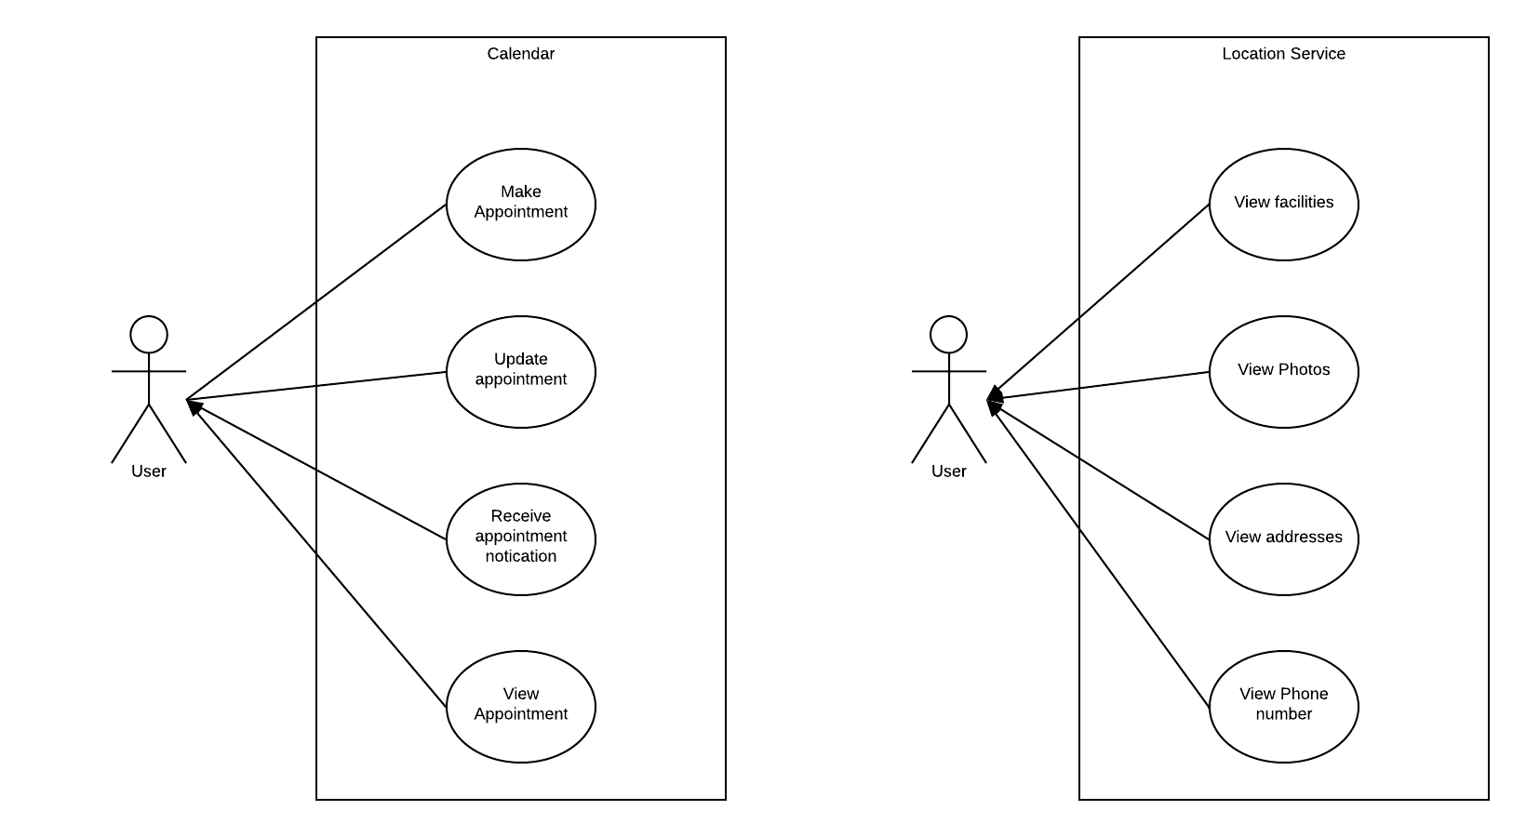
Calendar & Location Services

Slide 25
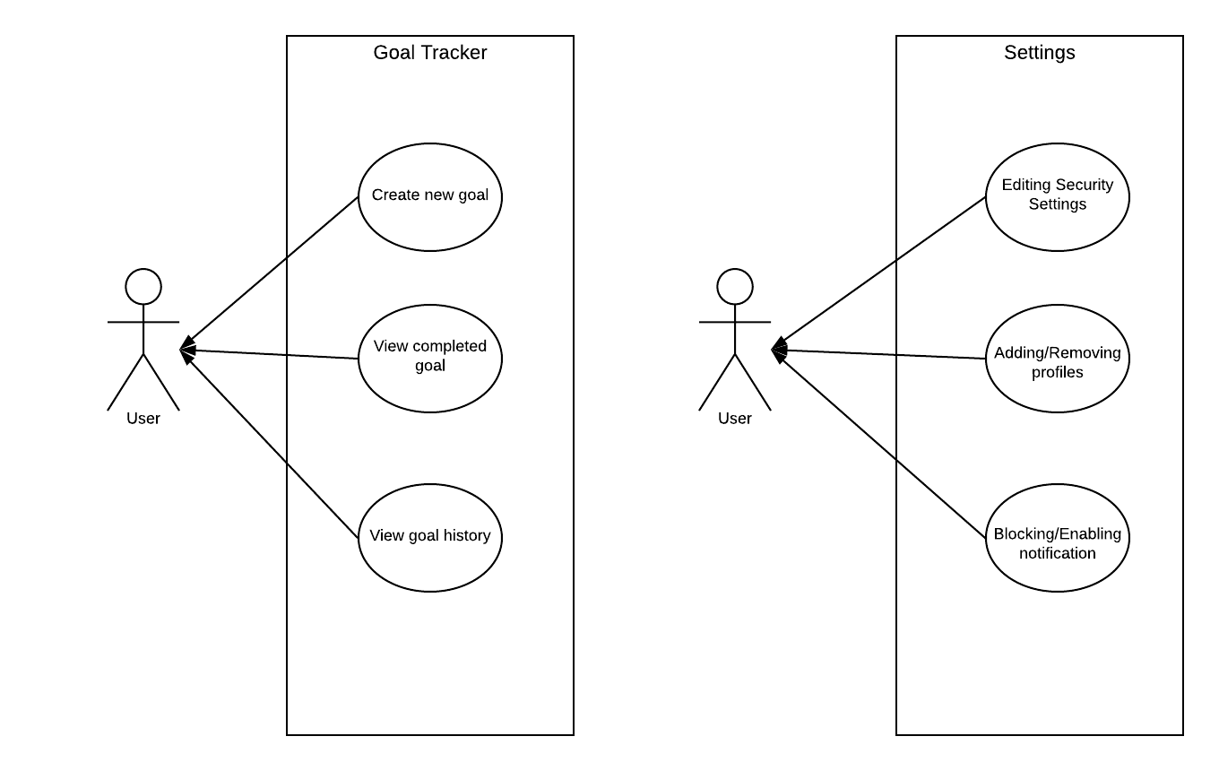
Goal Tracker and Settings

Slide 26

Any Questions?
We are excited for future project updates!
THANK YOU!
Follow us at
https://github.com/stevieclean/UNCG-CSE-Senior_Proj

